Slide 1
BUFF MANAGER
Jaume Montagut i Guix

Slide 2
Start downloading the files.

Slide 3
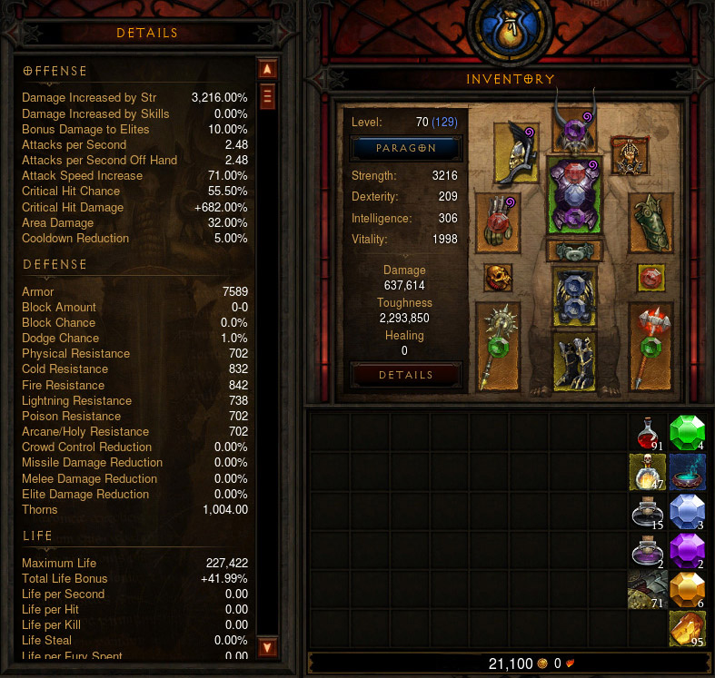
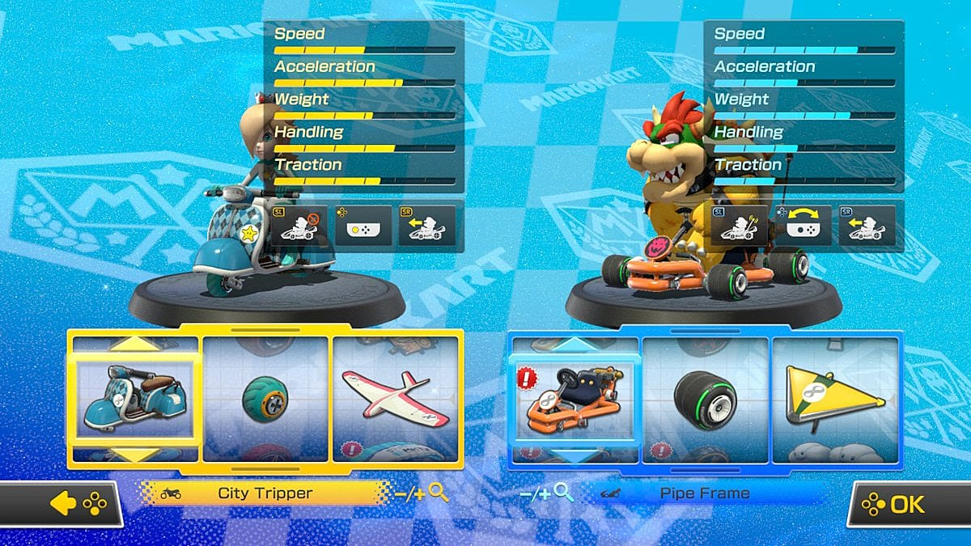
The importance

Slide 4
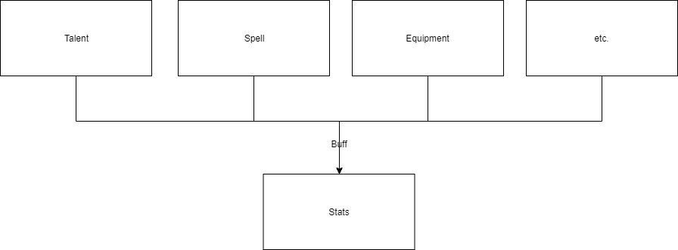
The problem
Notes:
The first thing that you may ask is
Systems
Equipment
Spells
Talent trees
Runes
Pets
Passives
Enviroment
Character types
Why do we need a stats manager?
Can’t we just have some ints and increment and decrement those?
When we have multiple systems
And in each system a lot

Slide 5
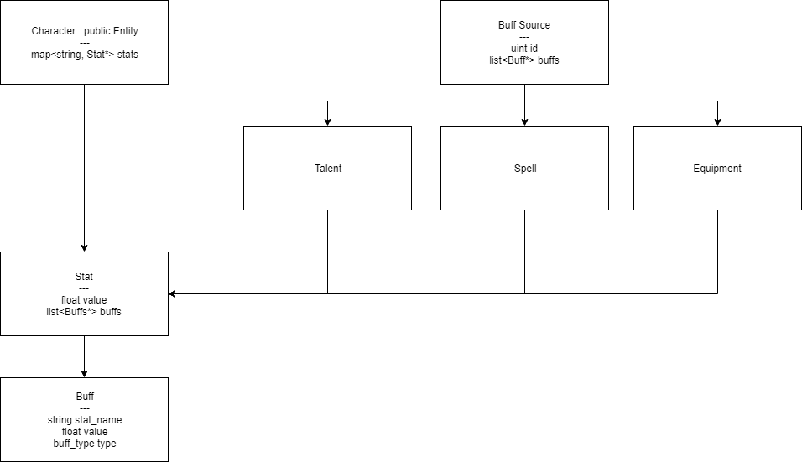
The idea

Slide 6
The project
2 characters
Dwarf = attacker
Goblin = defender
3 spells
Cut
Rage
Illumination

Slide 7
Damage
Base: 2
Spell 1: +8
Spell 2: +50%
Spell 1 > Spell 2
2 + 8 = 10
10 + 10 * 0.5 = 15
Spell 2 > Spell 1
2 + 2 * 0.5 = 3
3 + 8 = 11

Slide 8
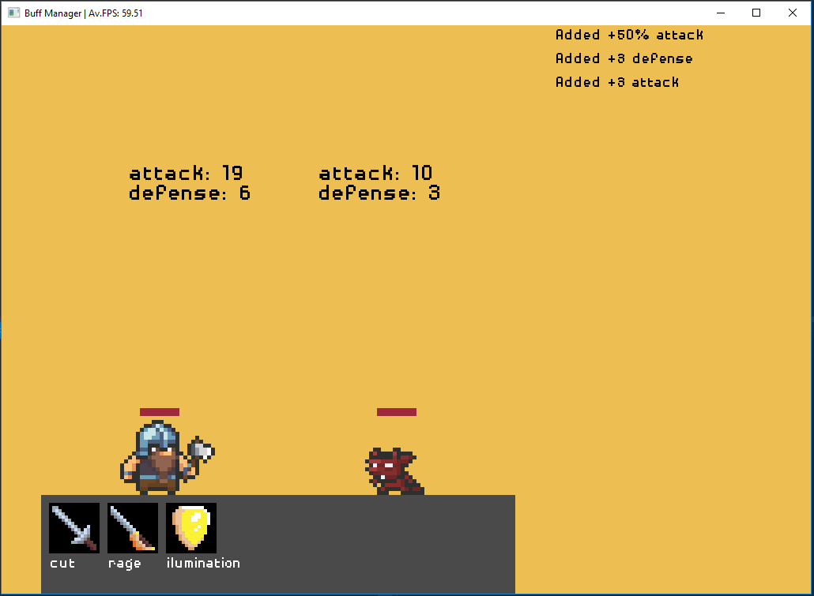
The TODO 1: Stat calculation
TODO 1: Calculate the final stat value as explained
First add all flat (additive) buffs
Then add all percent (multiplicative) buffs
Result:
When pressing “rage” or “illumination” stats should change like in the image.

Slide 9
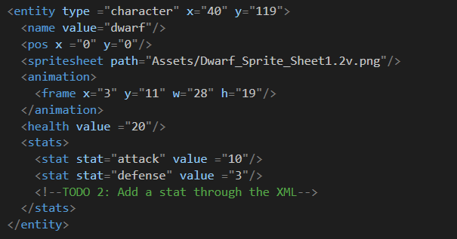
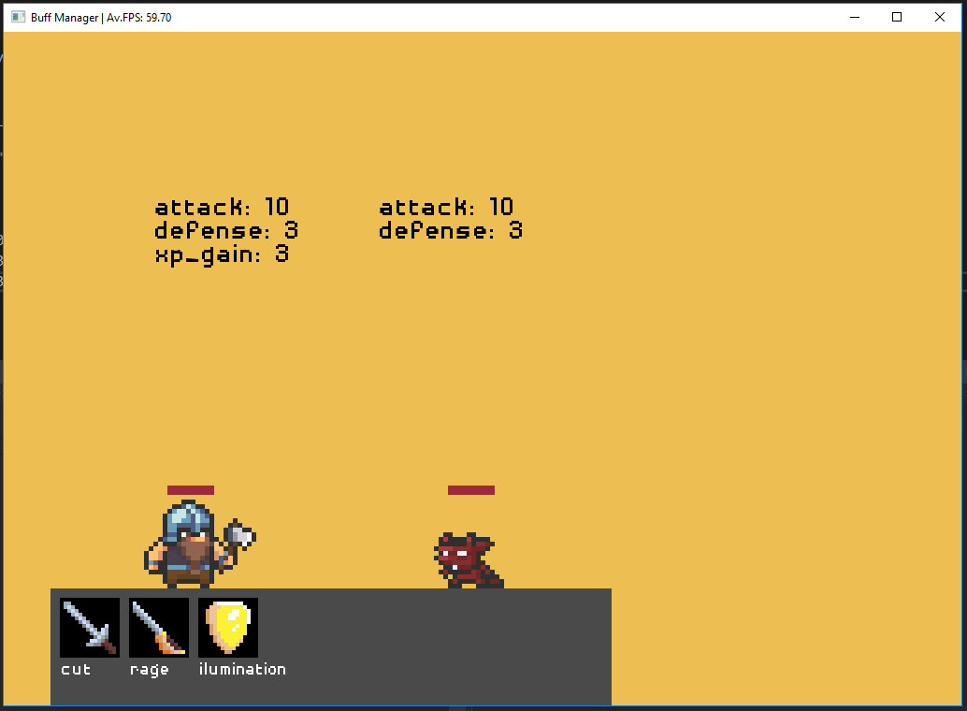
The TODO 2: Add a stat through the XML
TODO 2: Add a stat through the XML
Name it whatever you prefer, for example:
Intelligence
Dexterity
Strength
Result:
The stat name should appear above the character with the base value you entered

Slide 10
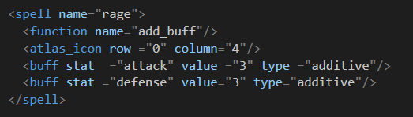

The TODO 3: Add a spell through the XML
TODO 3: Add a spell through the XML
Spell should modify the stat you just created in TODO 2
Leave function name as "add buff”
Choose the sprite you prefer in the atlas
Result:
New icon should appear bellow the character
When you press it, it should modify the stat you created

Slide 11
The TODO 4: Add a custom spell, p.1
Create a function similar to Cut() (found in Module_Buff.cpp)
Dwarf should deal damage to Goblin based on the stat you created in TODO 2
Result:
Wait for final part

Slide 12
The TODO 5: Add a custom spell, p.2
Create a new spell in the XML (same as before)
This time change the function name to the name of your spell
Result:
Wait for final part

Slide 13
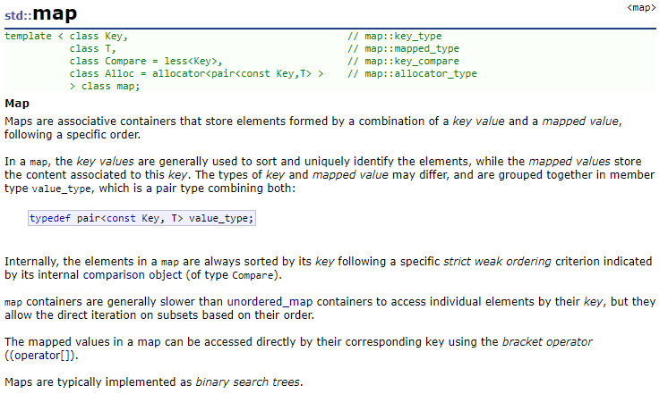
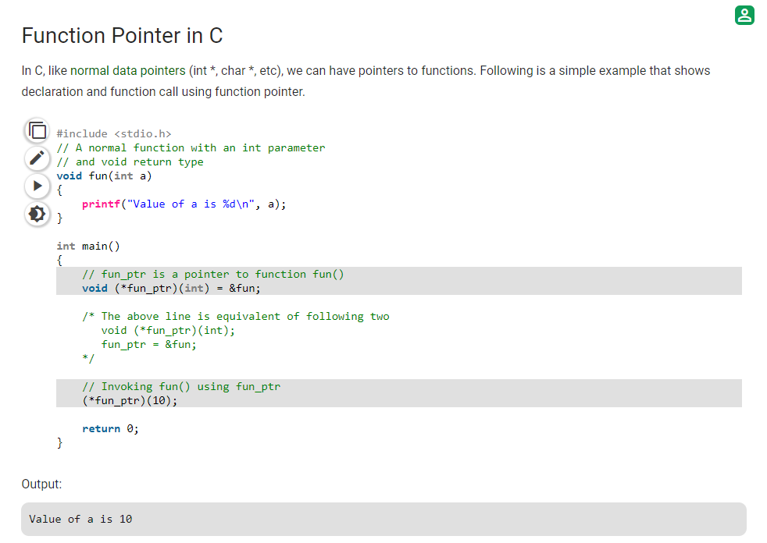
Dictionaries & function pointers

Slide 14
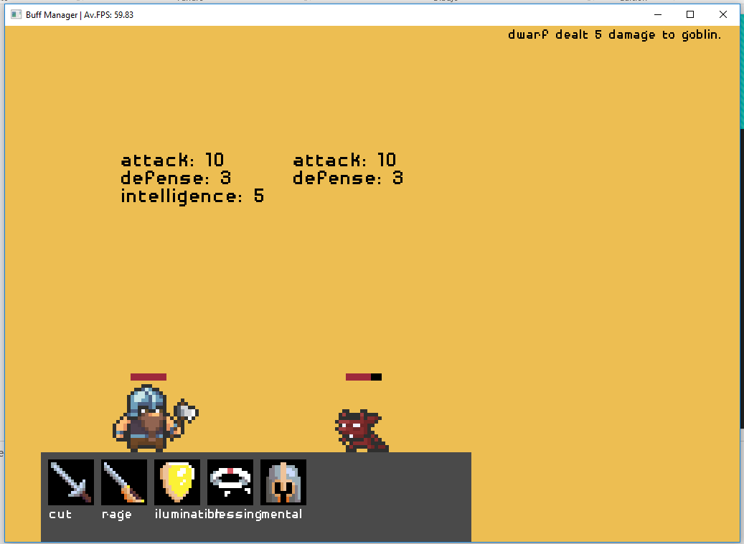
The TODO 6: Add a custom spell, p.3
Link the spell so that it’s called when you press it
Link the name you created in the XML with the function using the map
Result:
When you press the spell, it should deal damage to the goblin

Slide 15
Contact me: jaume.montagut.i.guix@gmail.com
Special thanks to:
Yessica Servin Dominguez
Alejandro Gamarra Niño

Slide 16
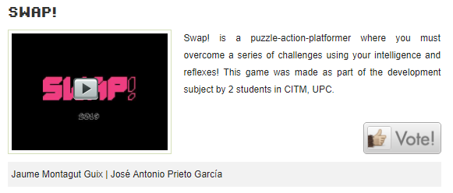
The spam
http://upcvideogames.com/juegos/

